Slide 1
ENHANCING CUSTOMER EXPERIENCE ANALYSIS
INSIGHTS AND STRATEGIES FOR IMPROVED RECOMMENDATIONS

Slide 2
INTRODUCTION
In today’s session, we dive deep into the data to uncover insights that will shape our strategies for improving customer recommendations. By exploring the relationships between various variables such as Seat comfort, Wi-Fi and connectivity, and more, we aim to provide actionable recommendations to elevate customer satisfaction. Let’s embark on this journey to decipher patterns, draw meaningful conclusions, and outline a roadmap for delivering an exceptional experience to British Airways passengers.

Slide 3
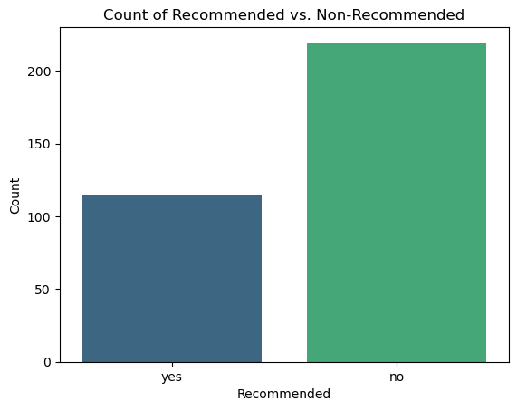
Recommended vs. Non-recommended

Slide 4
Recommended vs. Non-recommended Interpretation
In examining the Count plot comparing Recommended vs Non-recommended flights, a stark imbalance becomes evident. With 120 instances of positive recommendations and 280 instances of negative of negative recommendations, it’s clear that a substantial proportion of customer experiences fall within the non-recommended category.
This underscores the importance of identifying key factors influencing recommendations to strategically enhance overall customer satisfaction . Let delve deeper into the variables to pinpoint areas for improvement.

Slide 5
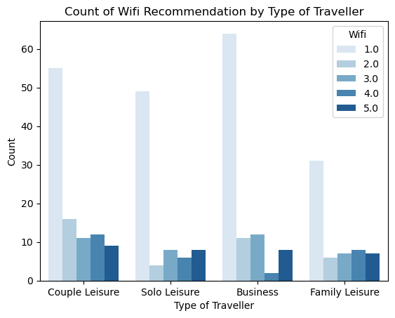
Wi-Fi Recommendation By Type of Traveler

Slide 6
Wi-Fi Recommendation By Type of Traveler Interpretation
The count plot examining Wi-Fi Recommendations across different types of travelers reveals intriguing patterns. Notable differences emerge:
Couple Leisure: Higher counts for Ratings 1-3 and 5, suggesting diverse opinions.
Solo Leisure: Consistently positive ratings, particularly for Ratings 4-5.
Business: Varied responses with a concentration in Ratings 1-3.
Family Leisure: A balanced distribution across all ratings.
These disparities underscore the need for tailored strategies in enhancing Wi-Fi services, acknowledging the diverse preferences among traveler types. Let’s further explore these insights to formulate targeted improvements.

Slide 7
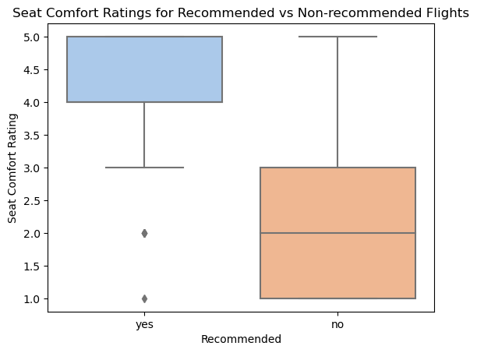
Seat Comfort Ratings for Recommended vs Non-recommended

Slide 8
Seat Comfort Ratings Interpretation
The Box Plot comparing Seat Comfort ratings for Recommended vs Non-recommended flights provides compelling insights. Emphasis lies in higher ratings for Recommended flights:
Recommended Flights(Yes): Concentration in the upper quartiles, indicating a generally favorable Seat Comfort experience.
Non-recommended Flights(No): Wider distribution with a notable presence in the lower quartiles, suggesting varied Seat Comfort experiences.
This distinction highlights Seat Comfort as a pivotal factor influencing positive recommendations. As we move forward, addressing and enhancing Seat Comfort becomes a key strategy to elevate overall customer satisfaction and recommendations.

Slide 9
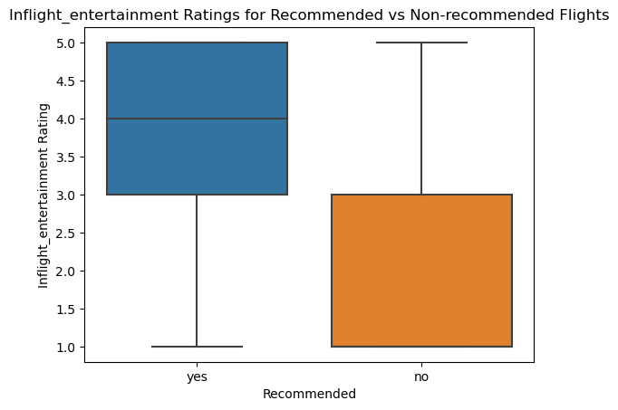
Inflight Entertainment Ratings for Recommended vs Non-Recommended

Slide 10
Inflight Entertainment Rating Interpretation
In the Box Plot comparing Inflight Entertainment ratings for Recommended vs Non-recommended flights, a positive correlation between higher ratings and recommendations emerges:
Recommended Flights(Yes): Concentration in the higher quartiles, indicating positive Inflight Entertainment experiences.
Non-recommended Flights(No): Widely distributed across quartiles, with a notable presence in the lower range, suggesting varying satisfaction levels.
This underlines the significance of Inflight Entertainment in shaping customer recommendations. Strengthening and enriching this aspect of the travel experience can contribute to higher overall satisfaction and positive endorsements. Let’s explore further to identify specific areas for improvement.

Slide 11
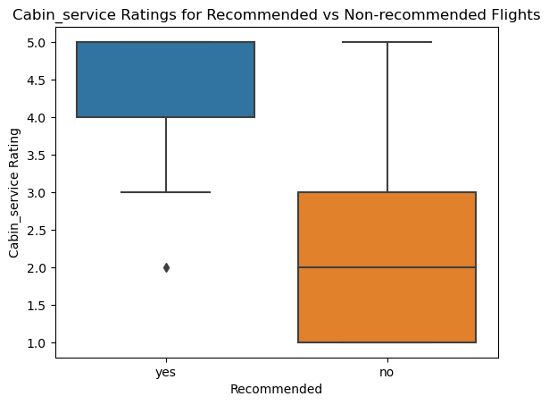
Cabin Staff Service Ratings for Recommended vs Non-Recommended

Slide 12
Cabin Staff Service Ratings Interpretation
The Box Plot comparing Cabin Staff Service ratings for Recommended vs Non-recommended flights sheds light on the significance of Cabin Staff Service in customer recommendations:
Recommended Flights(Yes): Concentration in the upper quartiles, highlighting positive Cabin Staff Service experiences.
Non-recommended Flights(No): Wider distribution with a presence in the lower quartiles, indicating varied satisfaction levels.
This underscores the pivotal role of Cabin Staff Service in shaping customer perceptions. Enhancing and maintaining high standards in cabin service is crucial for fostering positive recommendations. As we delve deeper, let’s pinpoint actionable strategies to further elevate the quality of Cabin Staff service.

Slide 13
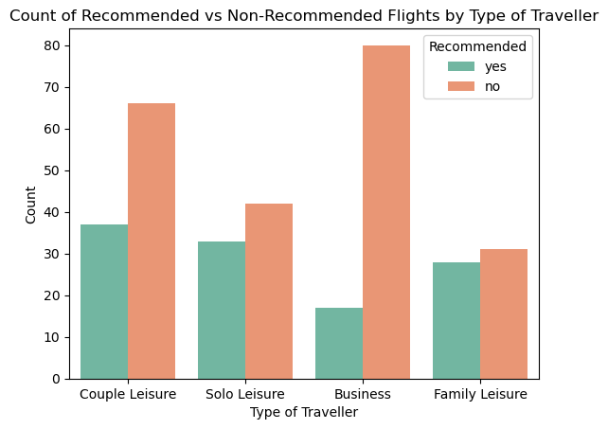
Recommended vs Non-recommended By Type of Traveler

Slide 14
Recommended vs Non-recommended by Type of Traveler Interpretation
The stacked Bar chart delving into counts of Recommended vs Non-recommended flights for each type of traveler provides valuable insights into their responses to recommendations:
Couple Leisure: A substantial proportion of non-recommended flights, indicating potential dissatisfaction.
Solo Leisure: A relatively balanced distribution, suggesting varied experiences and perceptions.
Business: A significant concentration in non-recommended flights, signaling a need for tailored improvements.
Family Leisure: A mix of recommended and non-recommended flights, emphasizing the need for targeted enhancements.
Understanding these variables is crucial for tailoring strategies to meet the distinct expectations and preferences of different traveler types.

Slide 15
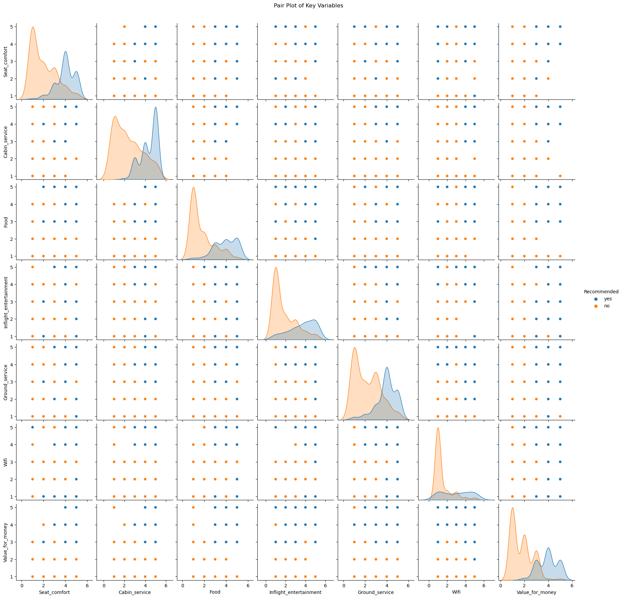
Pair Plot For Key Variables

Slide 16
Pair Plot For Key Variables Interpretation
The series of Pair plots examining relationships between seat comfort, cabin staff service, food, Inflight entertainment, ground service, Wi-Fi, value for money and recommendations reveals valuable patterns and correlations:
Seat Comfort(SC): Positive correlation with Value for money and Wi-Fi.
Negative correlation with Ground service and Cabin service.
Cabin Staff Service: Positive correlation with Inflight entertainment and Wi-Fi.
Negative correlation with Ground service and Seat comfort.
Food and Beverages: Positive correlation with Inflight entertainment.
Varied correlations with other variables.

Slide 17
Inflight Entertainment: Positive correlation Cabin staff service Wi-Fi and Food.
Varied correlations with other variables
Ground Service: Negative correlation with Wi-Fi, Seat Comfort, and Cabin staff service.
Varied correlations with other variables.
Wi-Fi and Connectivity: Positive correlation with Cabin staff service and Inflight entertainment.
Negative correlation with Ground service and Seat comfort.
Value for Money: Positive correlation with Seat comfort and Wi-Fi .
Negative correlation with Ground service.
Identifying these patterns equips us to target specific areas for improvement, optimizing the overall travel experience.

Slide 18
Pair Plots Analysis
The Pair Plots present a comprehensive view of relationships between key variables, offering insights, correlations and potential areas for improvement:
Seat Comfort:
Positive correlation with perceived Value for money and Wi-Fi..
Negative correlation with Ground service and Cabin service.
Cabin Staff Service: Positive correlation with Inflight Entertainment and Wi-Fi and connectivity.
Negative correlation with Ground service and Seat comfort.
Food And Beverages: Positive correlation with Inflight entertainment.
Varied correlations with other variables.
Inflight Entertainment: Positive correlation with Cabin Staff service , Wi-Fi and Food.

Slide 19
Inflight Entertainment: Positive correlation with Cabin Staff service , Wi-Fi and Food.
Varied correlations with other variables.
Ground Service: Positive correlation with Wi-Fi, Seat comfort and Cabin service.
Varied correlations with other variables.
Wi-Fi and Connectivity: Positive correlation with Cabin service and Inflight Entertainment .
Negative correlation with Ground service.

Slide 20
These insights illuminate opportunities for improvement:
Enhance Ground service to positively influence overall customer satisfaction.
Focus on reinforcing positive correlations, such as between Seat comfort and perceived Value for money.
Consider tailoring strategies based on correlations to address specific needs of diverse customer segments.
These findings serve as a roadmap for strategic enhancements, ultimately leading to an elevated travel experience and increased customer recommendations.

Slide 21
Conclusion
Recommendation Imbalance: A notable disparity exists, with 120 positive and 280 negative recommendations, emphasizing the need for targeted improvements.
Wi-Fi Variance Among Travelers: Diverse preferences among traveler types highlight the importance of tailoring Wi-Fi services to specific expectations.
Seat Comfort’s Pivotal Role: Higher Seat Comfort ratings correlate positively with recommendations, signaling its significance in shaping positive customer perceptions.
Inflight Entertainment Impact: Positive correlations between higher Inflight Entertainment ratings and recommendations emphasize its role in customer satisfaction.

Slide 22
Cabin Staff Service Influence: The significance of Cabin Staff Service is evident, with positive correlations and concentrated high ratings association associated with recommendations.
Tailored Strategies for Traveler Types: Varied responses across traveler types underscore the need to tailored strategies to meet diverse expectations.
These insights will inform targeted initiatives aimed at elevating overall customer satisfaction, driving positive recommendations and solidifying British Airways’ position as a preferred airline.

Slide 23
Recommendations
Implement measures to improve Seat comfort.
Invest in staff training programs to elevate the quality and efficiency of Cabin Staff service.
Explore technological advancements to enhance Wi-Fi connectivity and provide a seamless digital experience.
Develop tailored strategies for each traveler type, acknowledging their varied expectations.
Launch targeted marketing campaigns and services aligned with the traveler type preference.
Establish a continuous feedback loop to monitor the impact of implemented changes.

